Slide 1
Pt40Au60_AgBP1_hollow_shell_XA>XAP
2023-09-18

Slide 2
Input Parameters for DecomNano
Input Parameters (All) 200 data
Input Parameters (Droped parameters with no answer) 200 data
Parameter | Min | Max | Mean | Standard Deviation
dP | 2.8 | 2.8 | 2.8 | 0.0
dA | 2.9 | 2.9 | 2.9 | 0.0
fA | 0.6 | 0.6 | 0.6 | 0.0
nAA | 3.6 | 4.8 | 4.1 | 0.4
nPP | 9.3 | 9.3 | 9.3 | 0.0
nAP | 2.3 | 3.3 | 2.5 | 0.3
nPA | 0.2 | 1.4 | 0.4 | 0.3
DA | 4 | 20 | 8.5 | 3.1
DAP | 22 | 22 | 22.0 | 0.0
DP | 0 | 20 | 15.7 | 6.4
DAPh | 0 | 10 | 0.7 | 1.3
Parameter | Min | Max | Mean | Standard Deviation
dP | 2.8 | 2.8 | 2.8 | 0.0
dA | 2.9 | 2.9 | 2.9 | 0.0
fA | 0.6 | 0.6 | 0.6 | 0.0
nAA | 3.6 | 4.8 | 4.1 | 0.4
nPP | 9.3 | 9.3 | 9.3 | 0.0
nAP | 2.3 | 3.3 | 2.5 | 0.3
nPA | 0.2 | 1.4 | 0.4 | 0.3
DA | 4 | 20 | 8.5 | 3.1
DAP | 22 | 22 | 22.0 | 0.0
DP | 0 | 20 | 15.7 | 6.4
DAPh | 0 | 10 | 0.7 | 1.3

Slide 3
Ouput Parameters
Parameter | Min | Max | Mean | Standard Deviation
dP | 2.8 | 2.8 | 2.8 | 0.0
dA | 2.9 | 2.9 | 2.9 | 0.0
fA | 0.6 | 0.6 | 0.6 | 0.0
nAA | 3.6 | 4.8 | 4.1 | 0.4
nPP | 9.3 | 9.3 | 9.3 | 0.0
nAP | 2.3 | 3.3 | 2.5 | 0.3
nPA | 0.2 | 1.4 | 0.4 | 0.3
DA | 4 | 20 | 8.5 | 3.1
DAP | 22 | 22 | 22.0 | 0.0
DP | 0 | 20 | 15.7 | 6.4
DAPh | 0 | 10 | 0.7 | 1.3
nAM_AP | 4.6 | 10.1 | 7.0 | 1.7
nPM_AP | 9.5 | 11.8 | 10.0 | 0.5
nAA_AP | 0.0 | 3.8 | 1.1 | 0.9
nAP_AP | 4.6 | 8.2 | 5.9 | 1.1
nPA_AP | 0.2 | 3.1 | 0.8 | 0.5
nPP_AP | 7.6 | 9.5 | 9.2 | 0.3
XAP | 0.06 | 0.49 | 0.33 | 0.11
XA | 0.06 | 0.71 | 0.44 | 0.16
XP | 0.0 | 0.88 | 0.23 | 0.24
y | 0.02 | 0.4 | 0.12 | 0.08
dAP | 2.8 | 2.8 | 2.8 | 0.0
nMM_AP | 10.0 | 10.0 | 10.0 | 0.0
nAA_A | 5.3 | 9.8 | 7.4 | 1.2
nPP_P | 0.0 | 9.8 | 8.7 | 2.3
NA | 7.1 | 213.6 | 33.7 | 26.6
NP | 1.0 | 236.2 | 165.3 | 93.0
NAP | 285.0 | 285.0 | 285.0 | 0.0
XA*NA | 4.6 | 46.3 | 12.5 | 8.1
XP*NP | 0.0 | 207.7 | 53.8 | 56.8
XAP*NAP | 17.1 | 139.0 | 93.7 | 30.9
frac_XA*NA | 0.03 | 0.22 | 0.08 | 0.05
frac_XP*NP | 0.0 | 0.88 | 0.29 | 0.28
frac_XAP*NAP | 0.07 | 0.95 | 0.63 | 0.26
frac_Pt_P | 0.0 | 0.95 | 0.32 | 0.3
frac_Pt_PA | 0.05 | 1.0 | 0.68 | 0.3

Slide 4
Solution of DecomNano
Parameter | Min | Max | Mean | Standard Deviation
nAM_AP | 4.6 | 10.1 | 7.0 | 1.7
nPM_AP | 9.5 | 11.8 | 10.0 | 0.5
nAA_AP | 0.0 | 3.8 | 1.1 | 0.9
nAP_AP | 4.6 | 8.2 | 5.9 | 1.1
nPA_AP | 0.2 | 3.1 | 0.8 | 0.5
nPP_AP | 7.6 | 9.5 | 9.2 | 0.3
XAP | 0.06 | 0.49 | 0.33 | 0.11
XA | 0.06 | 0.71 | 0.44 | 0.16
XP | 0.0 | 0.88 | 0.23 | 0.24
y | 0.02 | 0.4 | 0.12 | 0.08

Slide 5
Other Parameters Calculated in the DecomNano
Parameter | Min | Max | Mean | Standard Deviation
dAP | 2.8 | 2.8 | 2.8 | 0.0
nMM_AP | 10.0 | 10.0 | 10.0 | 0.0
nAA_A | 5.3 | 9.8 | 7.4 | 1.2
nPP_P | 0.0 | 9.8 | 8.7 | 2.3
NA | 7.1 | 213.6 | 33.7 | 26.6
NP | 1.0 | 236.2 | 165.3 | 93.0
NAP | 285.0 | 285.0 | 285.0 | 0.0

Slide 6
Extracted Parameter Related to Hetereogeneity
Parameter | Min | Max | Mean | Standard Deviation
XA*NA | 4.6 | 46.3 | 12.5 | 8.1
XP*NP | 0.0 | 207.7 | 53.8 | 56.8
XAP*NAP | 17.1 | 139.0 | 93.7 | 30.9
y | 0.02 | 0.4 | 0.12 | 0.08
nAM_AP | 4.6 | 10.1 | 7.0 | 1.7
nPM_AP | 9.5 | 11.8 | 10.0 | 0.5

Slide 7
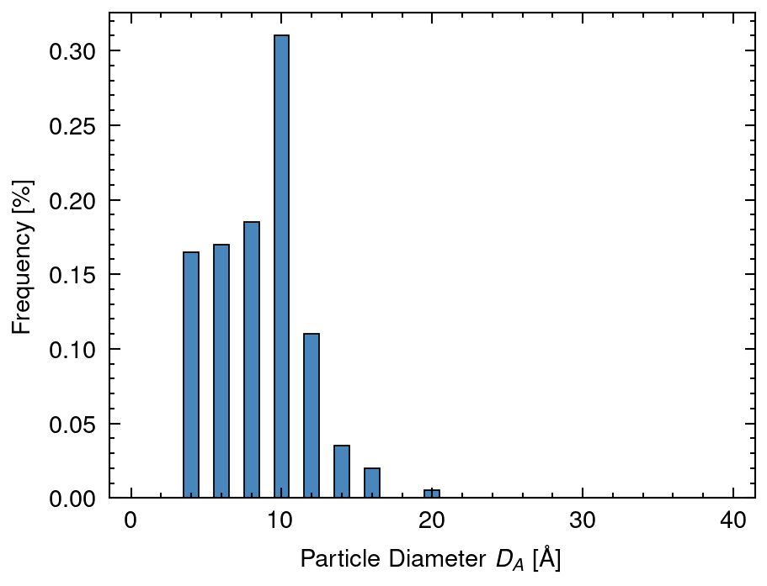
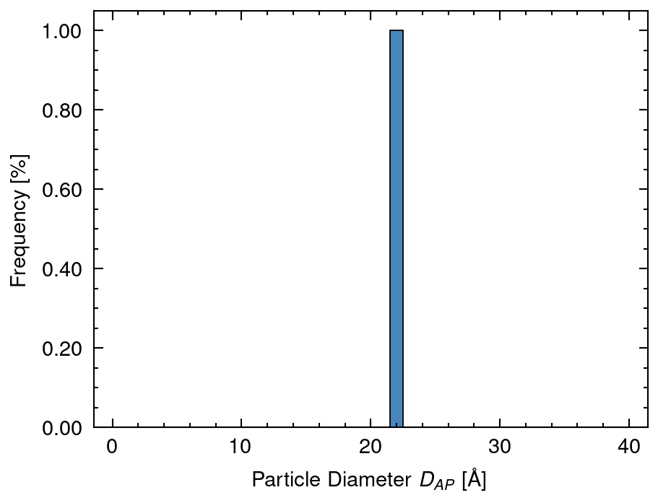
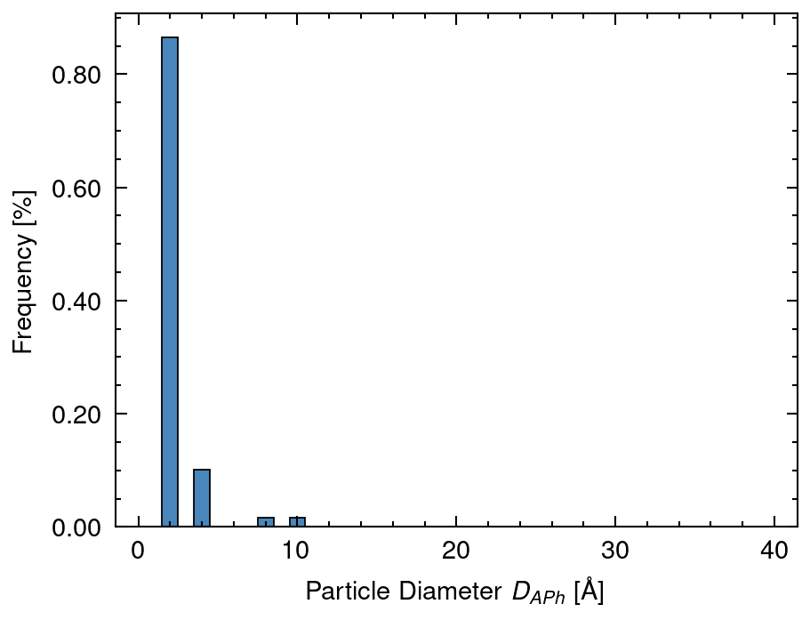
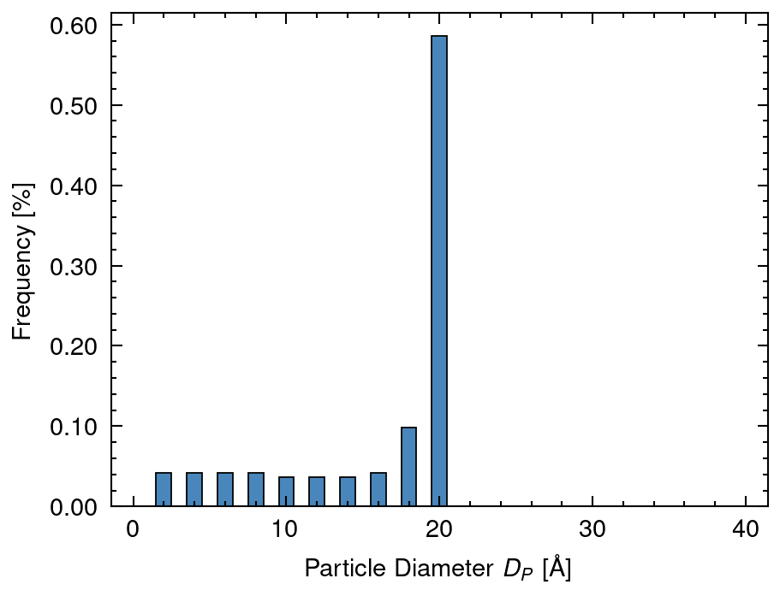
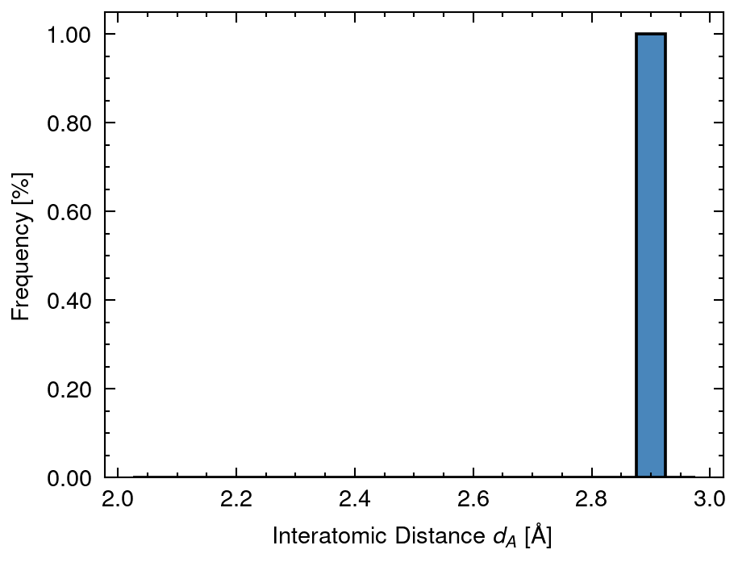
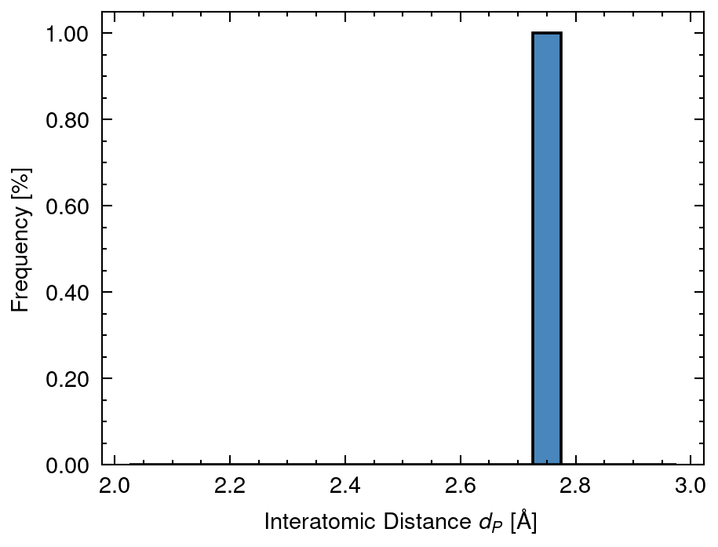
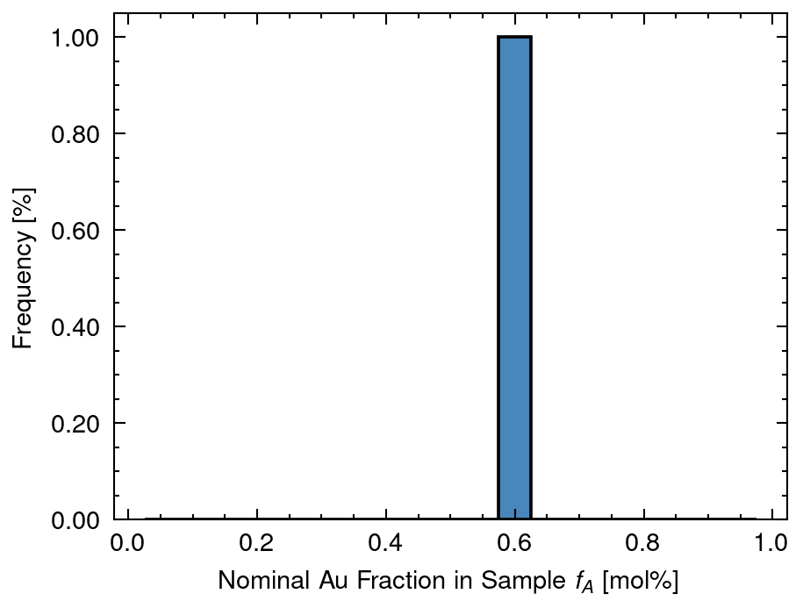
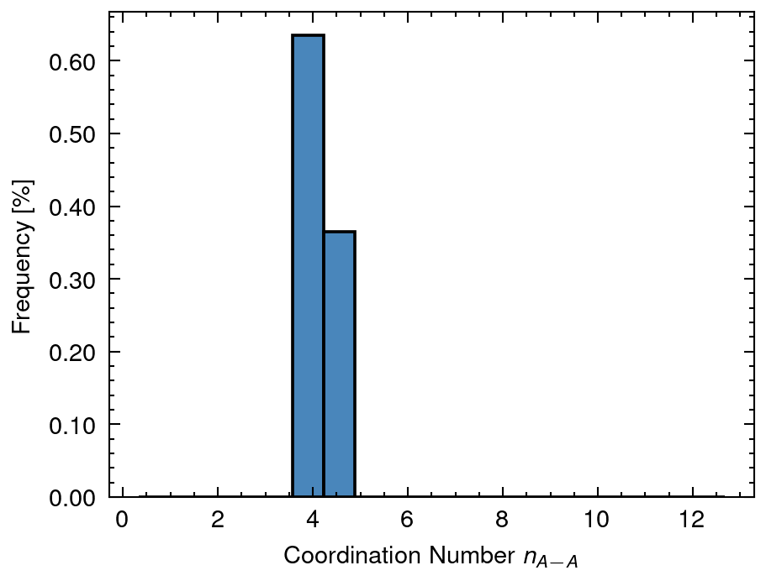
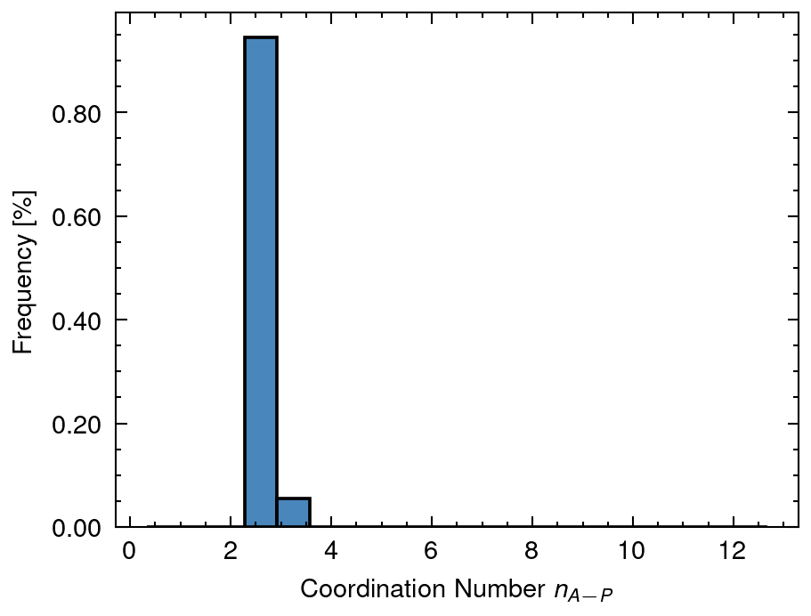
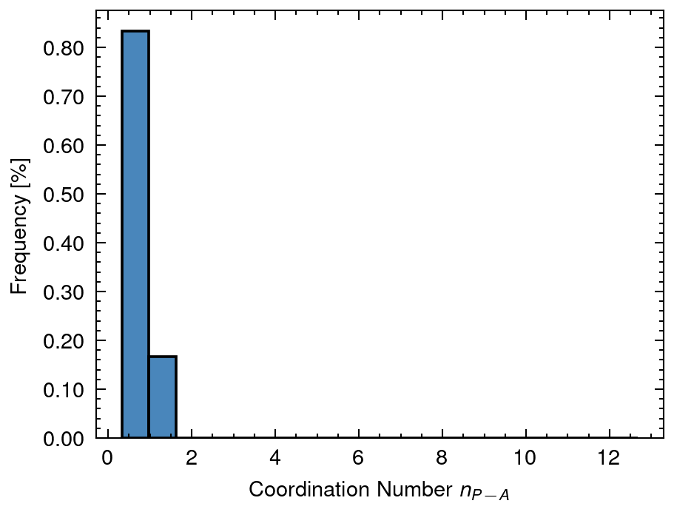
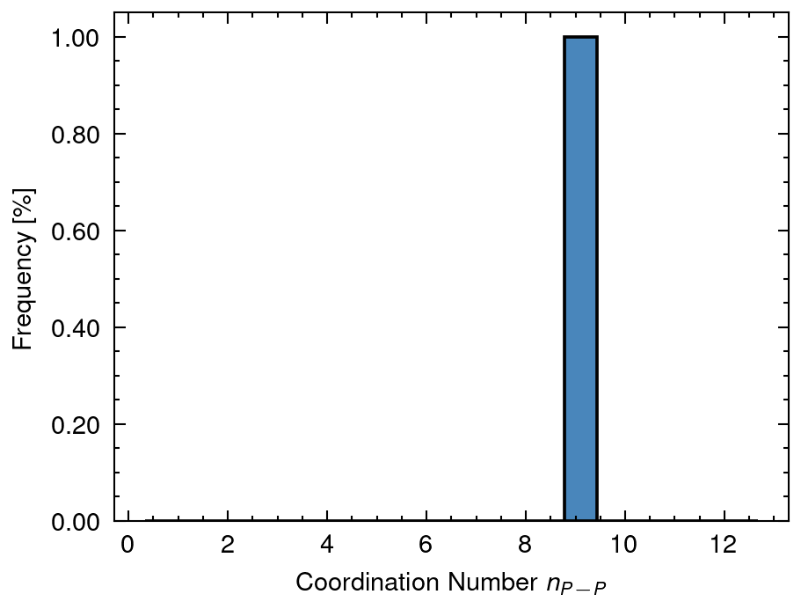
1 Distribution of input data
DA mean: 8.49 sd:3.06
DAP mean: 22.0 sd:0.0
DAPh mean: 0.72 sd:1.35
DP mean: 15.71 sd:6.37
dA mean: 2.88 sd:0.0
dP mean: 2.77 sd:0.0
fA mean: 0.6 sd:0.0
nAA mean: 4.14 sd:0.39
nAP mean: 2.49 sd:0.25
nPA mean: 0.44 sd:0.33
nPP mean: 9.3 sd:0.0

Slide 8
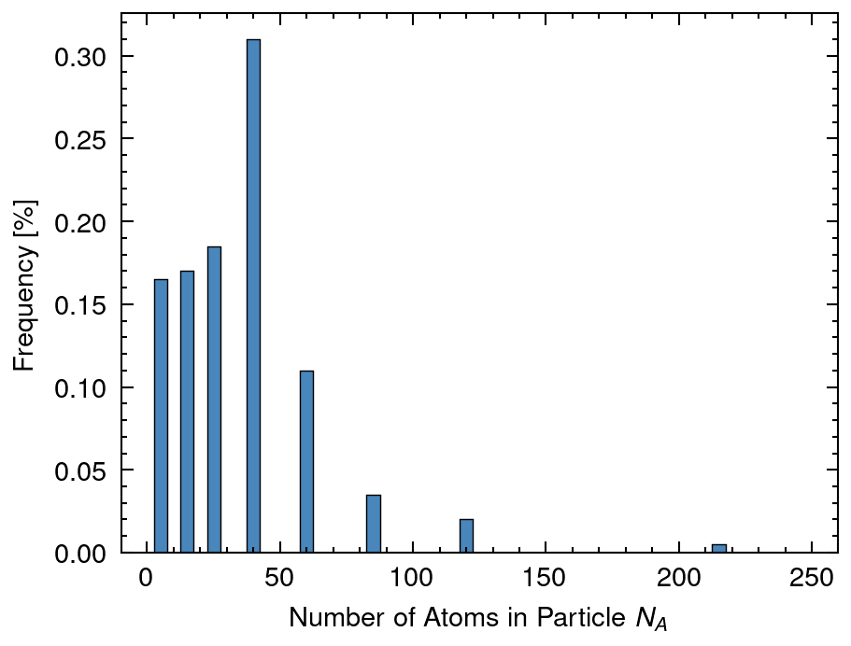
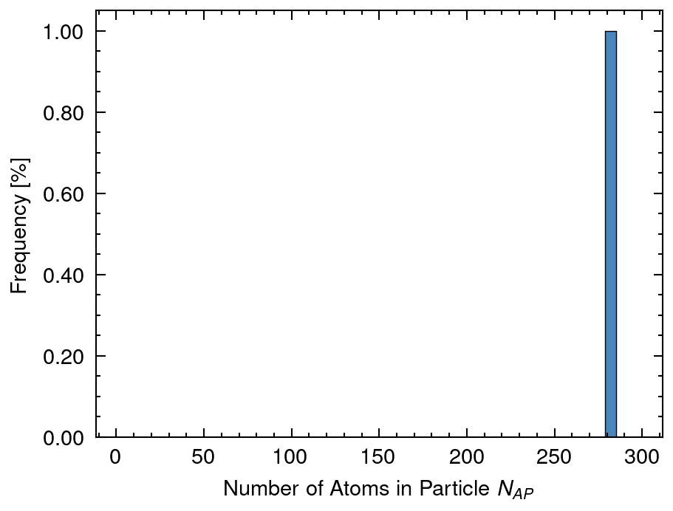
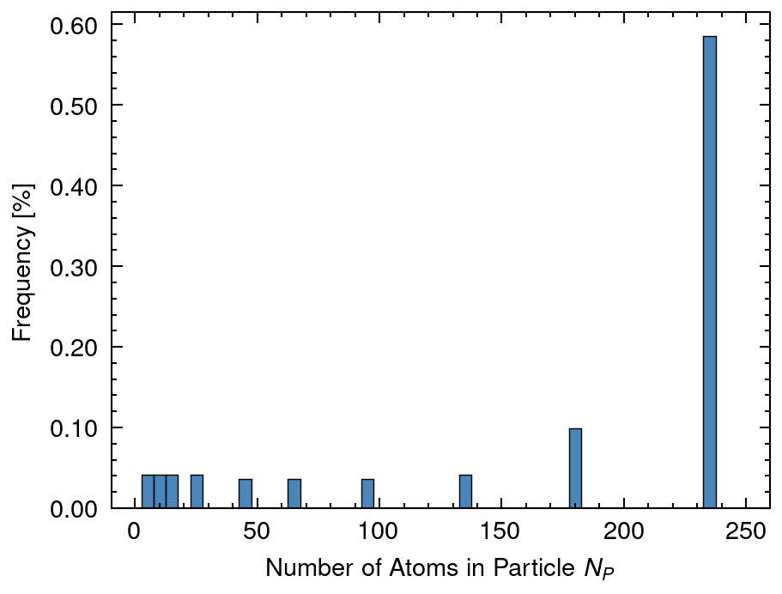
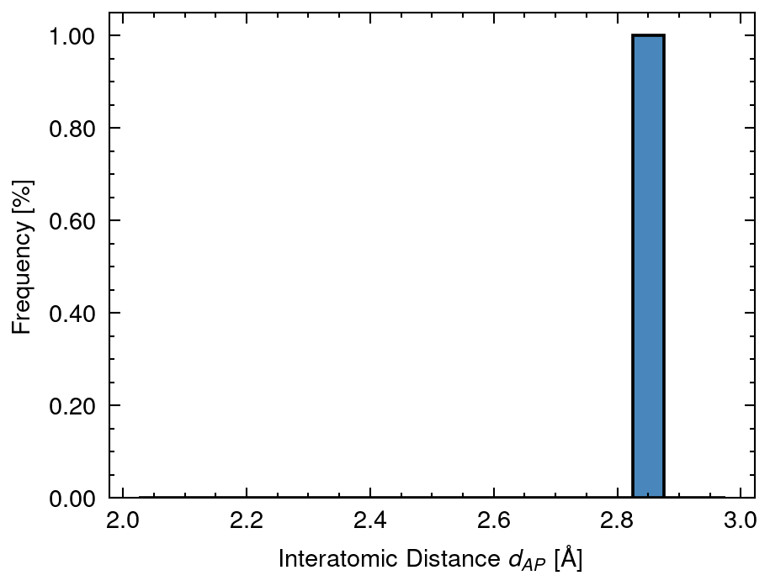
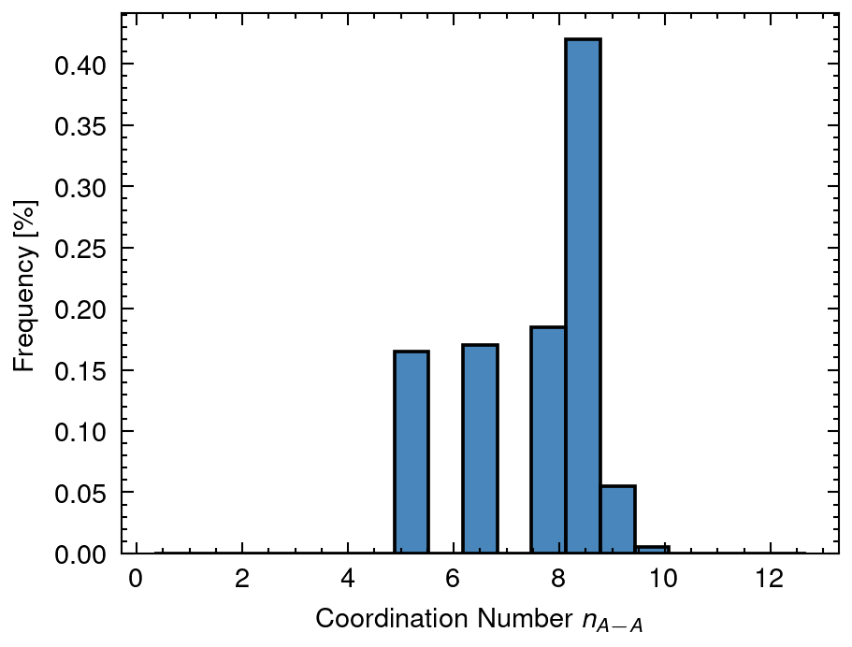
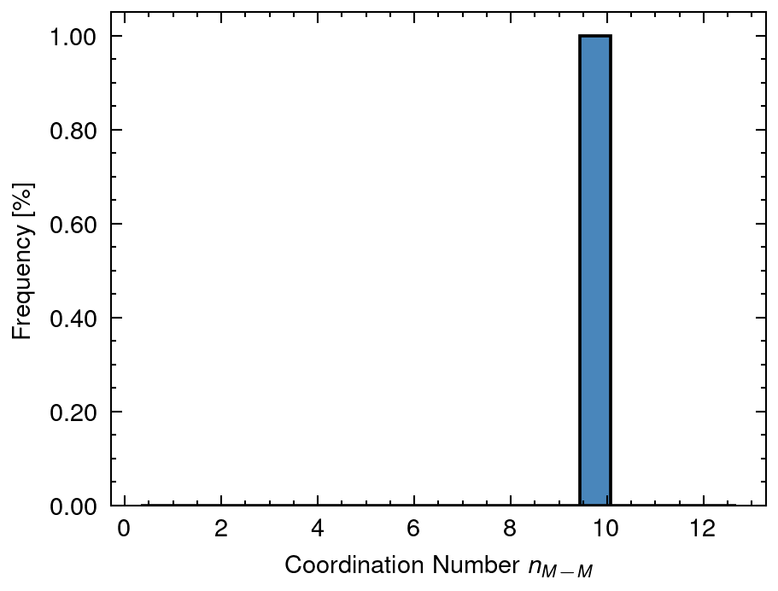
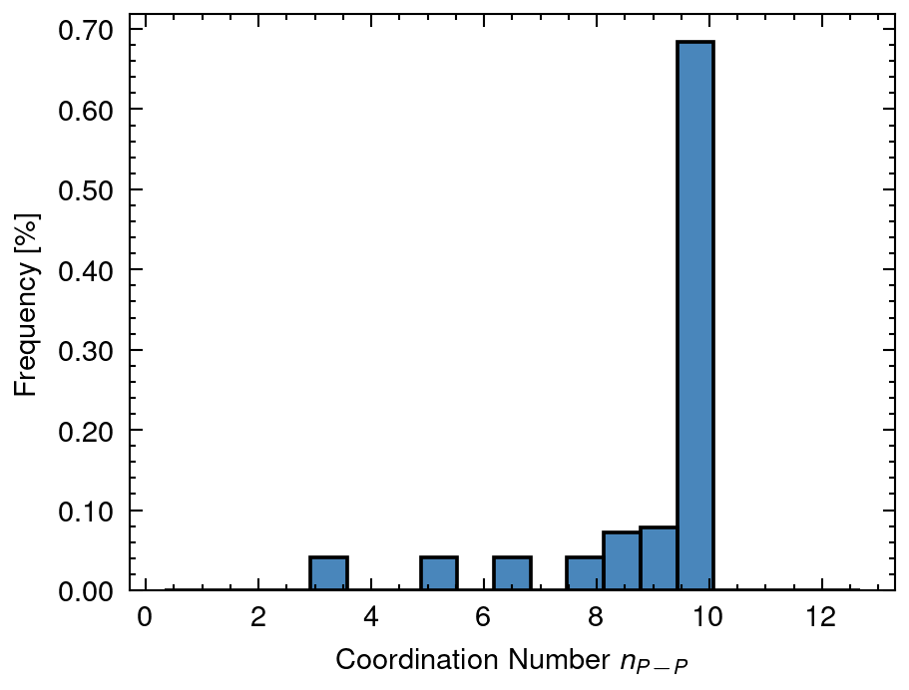
2 Distribution of calculated data
NA mean: 33.68 sd:26.6
NAP mean: 284.95 sd:0.0
NP mean: 165.26 sd:92.95
dAP mean: 2.84 sd:0.0
nAA_A mean: 7.4 sd:1.16
nMM_AP mean: 9.97 sd:0.0
nPP_P mean: 8.69 sd:2.29

Slide 9
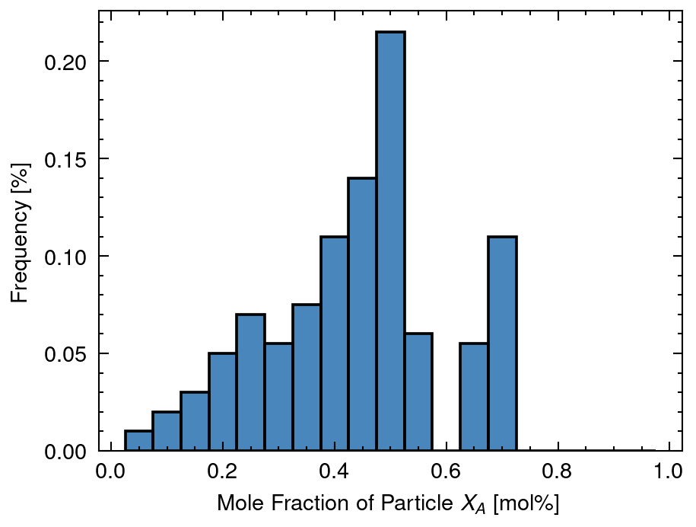
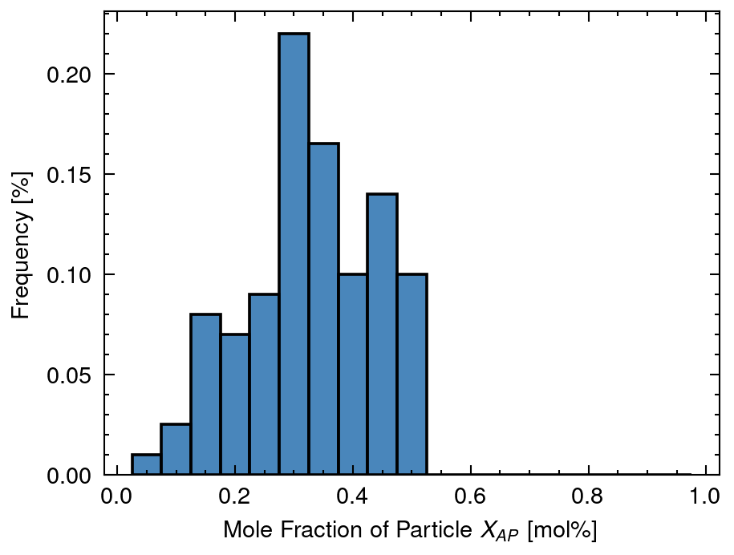
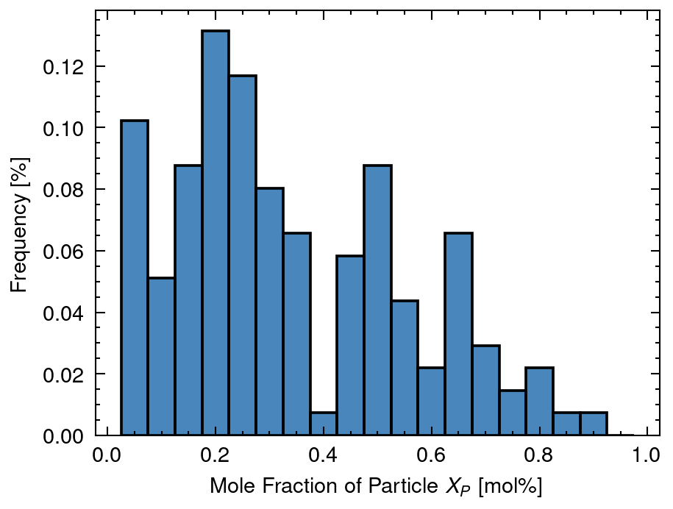
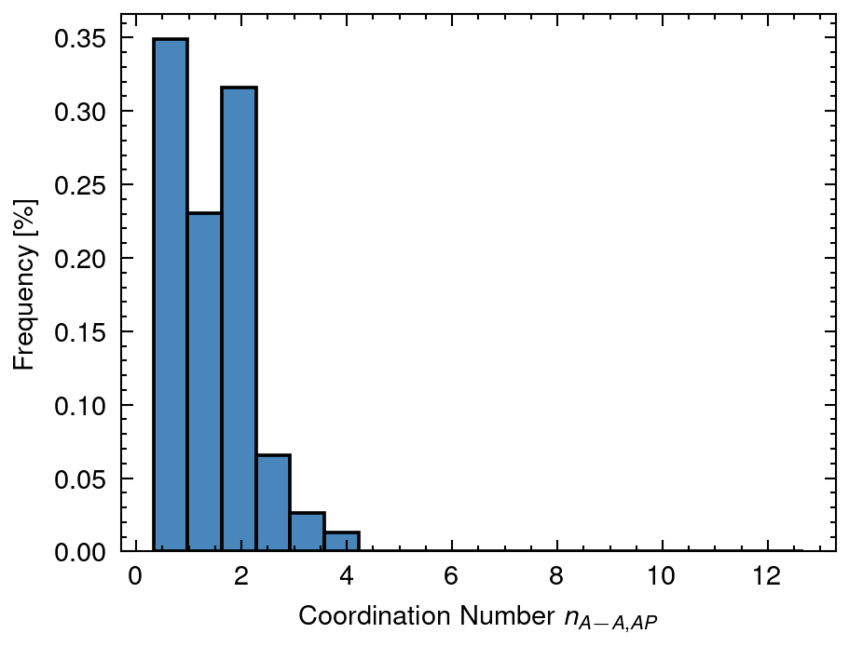
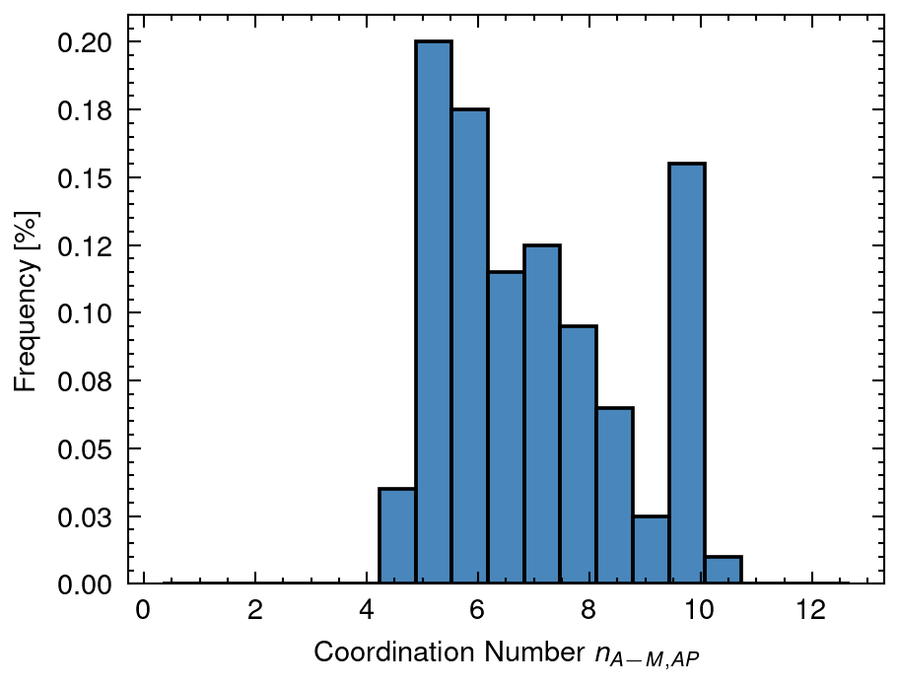
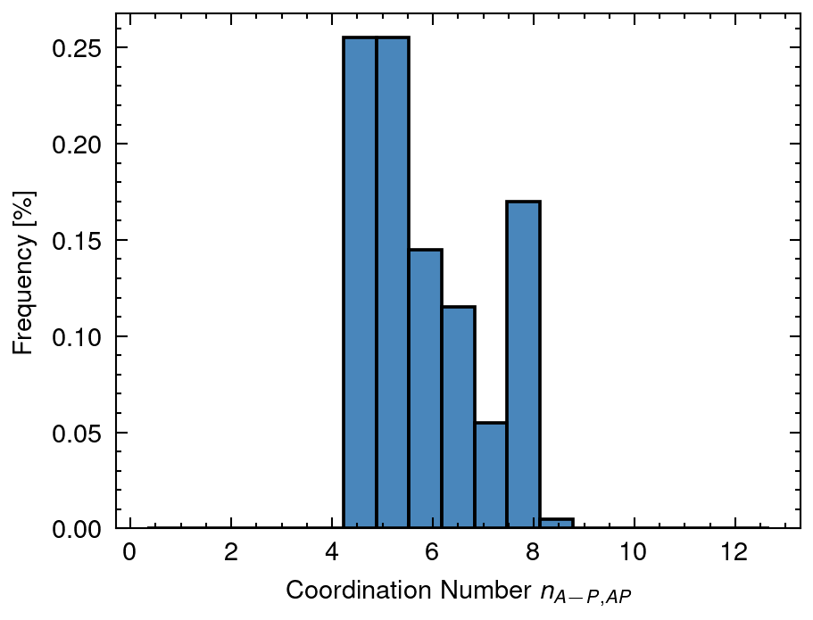
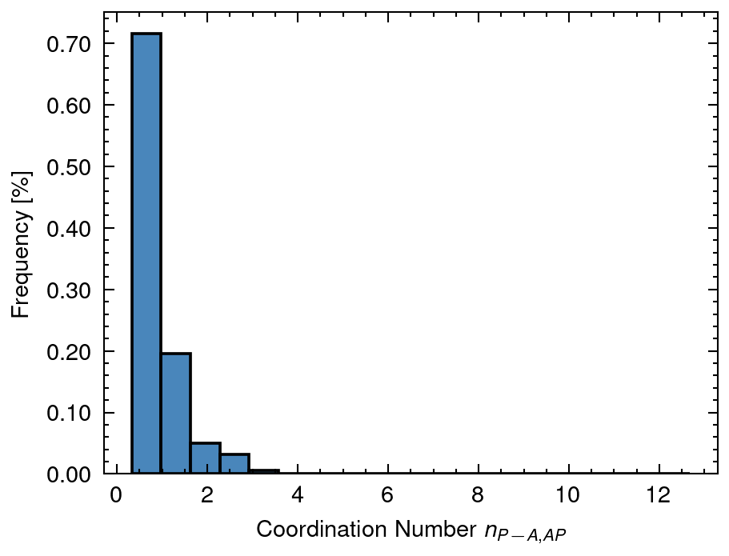
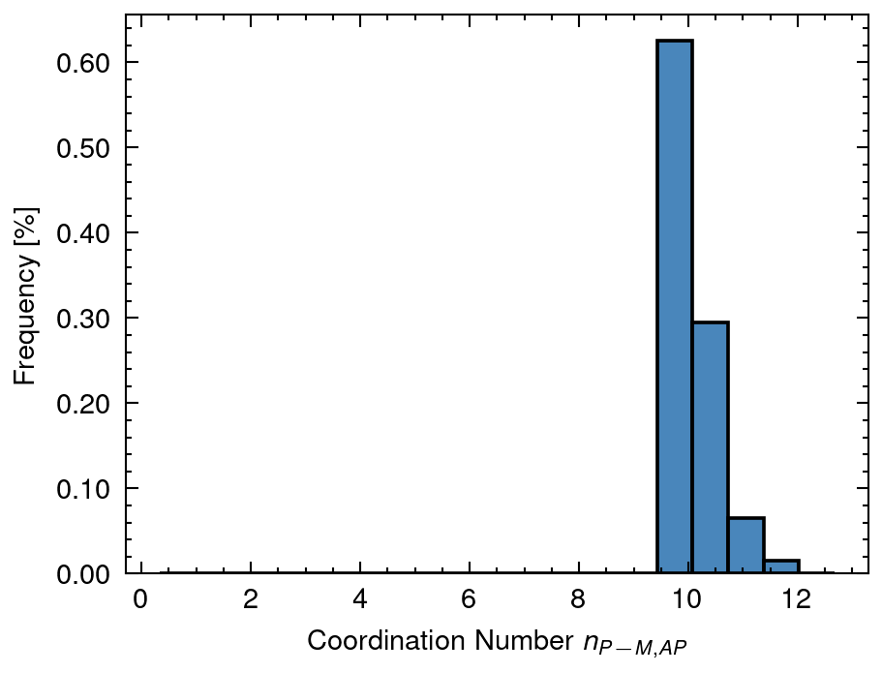
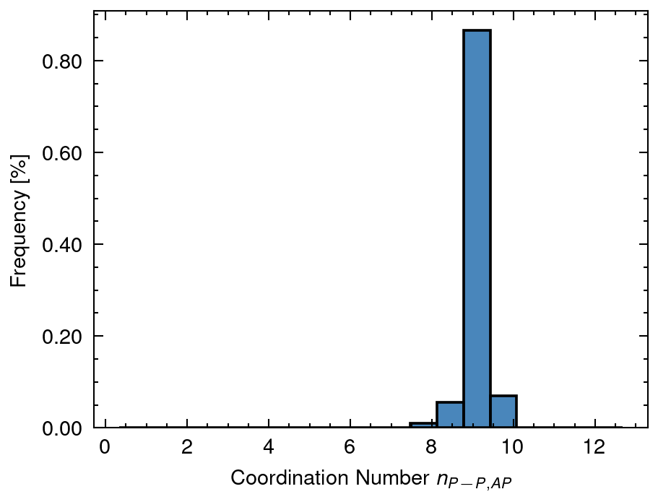
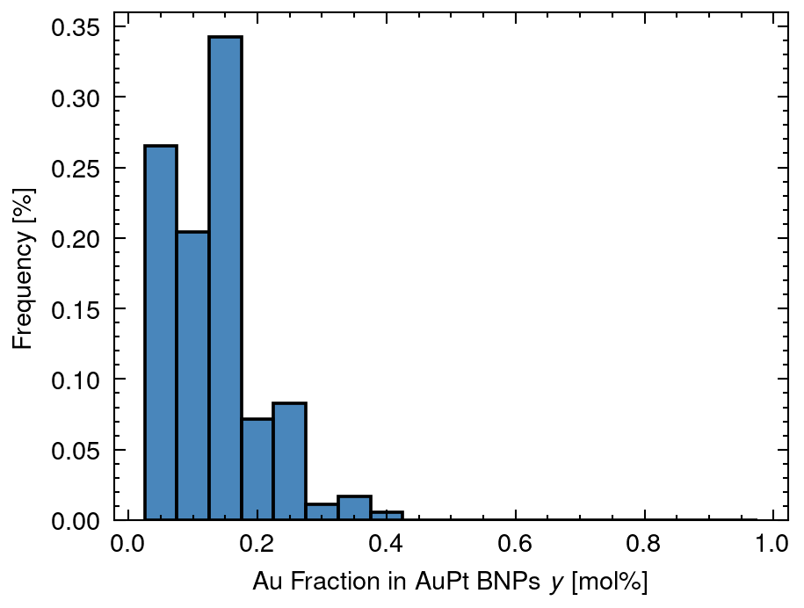
3 Distribution of solved data
XA mean: 0.44 sd:0.16
XAP mean: 0.33 sd:0.11
XP mean: 0.23 sd:0.24
nAA_AP mean: 1.13 sd:0.86
nAM_AP mean: 7.02 sd:1.68
nAP_AP mean: 5.89 sd:1.15
nPA_AP mean: 0.78 sd:0.54
nPM_AP mean: 9.96 sd:0.47
nPP_AP mean: 9.19 sd:0.26
y mean: 0.12 sd:0.08

Slide 10
4 Distribution of n (Overall Cordination Number)
nAA_A mean: 7.4 sd:1.16
nMM_AP mean: 9.97 sd:0.0
nPP_P mean: 8.69 sd:2.29

Slide 11
5 Distribution of X (Fraction of Nanoparticle)
XA mean: 0.44 sd:0.16
XAP mean: 0.33 sd:0.11
XP mean: 0.23 sd:0.24

Slide 12
6 Distribution of y (Fraction of Au in Nanoparticle)
y mean: 0.12 sd:0.08

Slide 13
7 Distribution of D (Diameter of Nanoparticle)
DA mean: 8.49 sd:3.06
DAP mean: 22.0 sd:0.0
DAPh mean: 0.72 sd:1.35
DP mean: 15.71 sd:6.37

Slide 14
8 Distribution of n (Coordination Number of Nanoparticle)
nAA_AP mean: 1.13 sd:0.86
nAM_AP mean: 7.02 sd:1.68
nAP_AP mean: 5.89 sd:1.15
nPA_AP mean: 0.78 sd:0.54
nPM_AP mean: 9.96 sd:0.47
nPP_AP mean: 9.19 sd:0.26

